Slide 1
The Apple Card

Slide 2
Overview
Designed to be used almost exclusively with Apple Pay and the Wallet app. The card is only available in the U.S.
Customer support through iMessage.
There are no fees associated with having an Apple Card— no late fees, no annual fee, no cash-advance fee, and no over-the-limit fee.
There is no penalty for a missed payment.
Payments can be scheduled from the Wallet app.
Built on iOS platform.

Slide 3
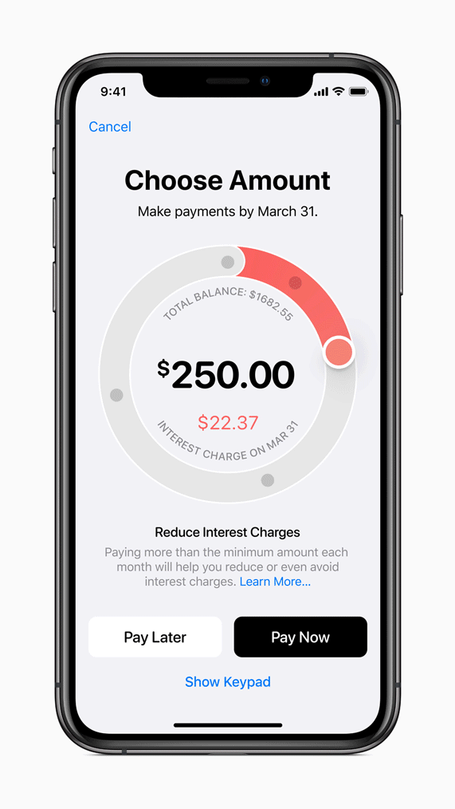
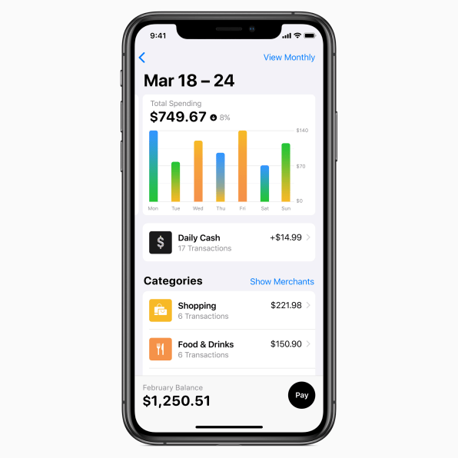
April 26, 2019

Slide 4
Business activities
Apple currently has an active installed base of devices 1.4 billion, 193 million U.S. users.
User base creates opportunity to take advantage of their large captive customer base as every Apple customer is a potential credit card client.
No fees business model addresses address customer concerns regarding high and numerous credit card fees
Encourages cardholders to take advantage of the card’s financial wellness tools

Slide 5
Landscape
$870 billion U.S. debt
Over 480 million credit cards in circulation. With ~330 million people in the U.S., this is equates to 1.5 credit cards per person
The average U.S. credit card consumer has ~$6,000 in debt & 30% utilization.
Cross-section: 67% of the U.S. population owns a credit card & 193 million active U.S. iPhone users
Mobile payments still under utilized in the U.S., less than 10% adoption campare to tradition payment methods at ~80%.

Slide 6
Results
Card launched 8/2019 so little to no data on how success
Key metrics needed to gauge success:
Number of applicants
Utilizations
Interest income
Delinquency rate

Slide 7
Recommendations
The Apple Card represents a great intersection of finance and technology:
Offer banking products as well. Such as, checking and savings accounts.
Debit card that can be paired with the Apple Card
Utilize same physical card and be completely managed from the customers phone… will help to minimize the number of cards a consumer has to carry in their wallet
Provide greater insight, security, and privacy over their financial lives, which can lead to better decision making.

